Slide 1
EE 150
Intermediate Programming Concepts for Engineers
Lecture Notes on
Dynamic Memory Allocation II
1

Slide 2
Storage of Matrices
Consider a statically-allocated matrix in C that is declared using a 2-dimensional array --- for example:
#define ROWS 3
#define COLUMNS 4
int matrix[ROWS][COLUMNS] = { {1, -1, 8, 2},
{0, 3, 4, 2},
{1, -1, 0, 5}};
How is this actually stored in computer memory?
When we ask for matrix[1][2], how does that work?
1 | -1 | 8 | 2
0 | 3 | 4 | 2
1 | -1 | 0 | 5

Slide 3
Storage of Matrices
A two-dimensional array is stored row-by-row in a contiguous block of memory that contains (ROWS * COLUMNS * sizeof(int)) bytes
Element (i, j) of the matrix is stored at the following address: matrix[i][j] → starting_address + (i * COLUMNS + j) * sizeof(int)
This can be viewed as a one-dimensional array with a total of ROWS*COLUMNS elements. And element (i, j) of the matrix is element (i*COLUMNS +j) of a one dimensional array.
This relationship is useful to keep in mind when managing matrices dynamically
1
-1
8
2
0
3
4
2
1
-1
0
5

Slide 4
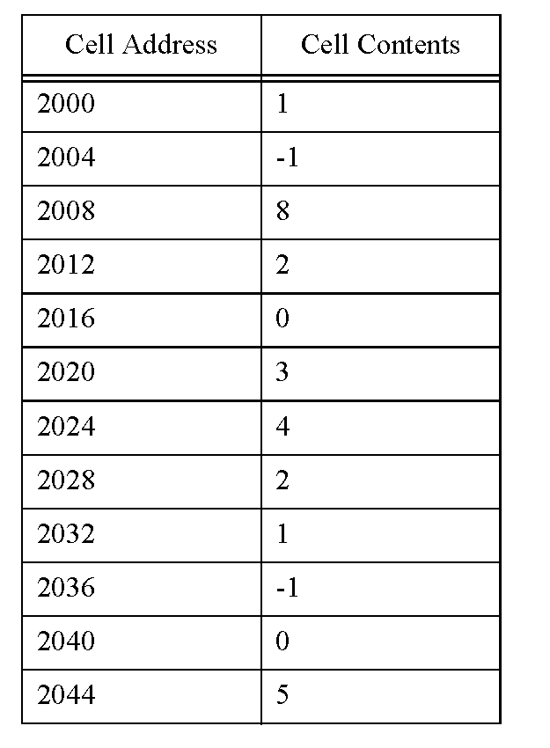
Matrix Storage Example
Suppose we have an int matrix with 3 rows and 4 columns. Assume that the starting address is 2000 and sizeof(int) = 4. Table shows the memory locations and their contents.
#define ROWS 3
#define COLUMNS 4
int matrix[ROWS][COLUMNS]
= {{1, -1, 8, 2},
{0, 3, 4, 2},
{1, -1, 0, 5}};
Recall that matrix[i][j] → START + (i * COLUMNS + j) * sizeof(int)
For example:
matrix[2][ 2] is located at 2000 + (2 * 4 + 2) * 4 = 2040
matrix[1][3] is located at 2000 + (1 * 4 + 3) * 4 = 2028

Slide 5
Example: A matrix as a one-dimensional array
#include <stdlib.h>
#include <stdio.h>
#define ROWS 3
#define COLUMNS 4
int main(void)
{
int matrix[ROWS * COLUMNS] = {1, -1, 8, 2, 0, 3, 4, 2, 1, -1, 0, 5};
int i = 0, j = 0;
printf("Enter i, j: ");
/* Check for invalid row and column index. */
if ((scanf("%d%d", &i, &j) != 2) || (i < 0) ||
(i >= ROWS) || (j < 0) || (j >= COLUMNS)) {
fprintf(stderr, "Invalid indexing.\n");
exit(1);
}
printf("matrix[%d][%d] = %d\n", i, j, matrix[(i * COLUMNS) + j]);
return 0;
}

Slide 6
Dynamic Arrays
One-dimensional arrays
#define SIZE 10 /*number of elements of the array*/
int *p1;
p1 = (int *) malloc ( SIZE * sizeof(int));
To access each element: p1[i] , where 0 ≤ i ≤ SIZE-1
Two-dimensional arrays
#define ROWS 10 #define COLUMNS 5 int *p2; p2 = (int *) malloc ( ROWS*COLUMNS * sizeof(int));
To access each element: p2[i * COLUMNS + j] , where 0 ≤ i ≤ ROWS-1 and 0 ≤ i ≤ COLUMNS-1

Slide 7
Matrices Example
The following code example (“Matrices example”) illustrates these points
Management of a heterogeneous collection of matrices (i.e., matrices with different dimensions)
… this collection is managed as an array of matrices, where each matrix is stored in an array
Management of dynamically allocated matrices as one dimensional arrays
The “pointer to pointer” data type int **matrices;

Slide 8
Matrices example, code part 1
/*************************************************************************
STORING MATRICES EXAMPLE
**************************************************************************/
#include <stdio.h>
#include <stdlib.h>
void matrix_display(int *matrix, int row_count, int column_count);
int main(void)
{
/* A pointer to a collection of matrices. Each matrix is to be stored
row-by-row as a 2-D array of integers. */
int **matrices = NULL;
/* Row and column counts to make the code more readable. */
int rows = 0, columns = 0;
int i = 0, j = 0; /* Loop iteration indices. */

Slide 9
Matrices example, code part 2
/* Allocate space to hold two matrices. */
matrices = malloc(2 * sizeof (int *));
/* Allocate space for a 3 x 2 matrix for the first matrix. */
rows = 3;
columns = 2;
matrices[0] = malloc(rows * columns * sizeof(int));
/* Fill in some values for the first matrix. */
for (i = 0; i < rows; i++) {
for (j = 0; j < columns; j++) {
(matrices[0])[(i * columns) + j] = (i + 1) % (j + 1);
}
}
/* Allocate space for a 1 x 5 matrix for the second matrix. */
rows = 1;
columns = 5;
matrices[1] = malloc(rows * columns * sizeof(int));

Slide 10
Matrices example, code part 3
/* Fill in some values for the second matrix. */
for (i = 0; i < rows; i++) {
for (j = 0; j < columns; j++) {
(matrices[1])[(i * columns) + j] = (j + 1) / (i + 1);
}
}
/* Print out the matrices. */
matrix_display(matrices[0], 3, 2);
matrix_display(matrices[1], 1, 5);
/* Print out a 2 x 3 interpretation of the first matrix. */
matrix_display(matrices[0], 2, 3);
return 0;
}

Slide 11
Matrices example, code part 4
void matrix_display(int *matrix, int row_count, int column_count)
{
int i, j;
printf("--------\n"); /* Display a separator */
for (i = 0; i < row_count; i++) {
for (j = 0; j < column_count; j++) {
/* Print a preceding separator unless this is the first
column. */
if (j > 0) {
printf(", ");
}
printf("%d", matrix[i * column_count + j]);
}
printf("\n");
}
}

Slide 12
Matrices example: output
--------
0, 1
0, 0
0, 1
--------
1, 2, 3, 4, 5
--------
0, 1, 0
0, 0, 1

Slide 13
Memory Layout Assumptions
For purposes of illustration, we assume:
Each integer and pointer variable occupies four bytes
The “matrices” variable is stored at location (memory cell address) 400
The first malloc (creating space for pointers to two matrices) allocates a block that starts at location 50
The second malloc (creating space for a 3x2 array of int) allocates a block that starts at location 180
The third malloc (creating space for a 1x5 array of int) allocates a block that starts at location 320
In this example, memory cell addresses and contents are represented in base 10

Slide 14
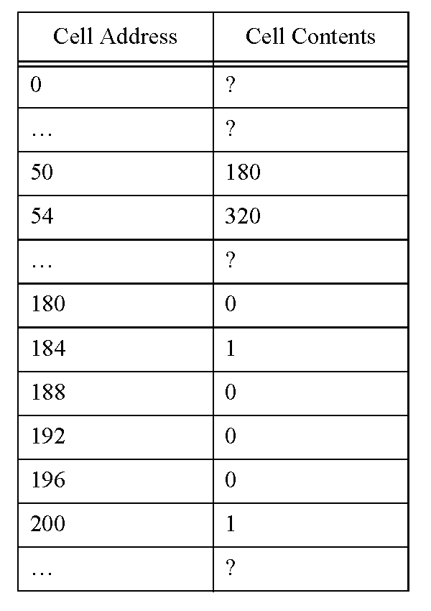
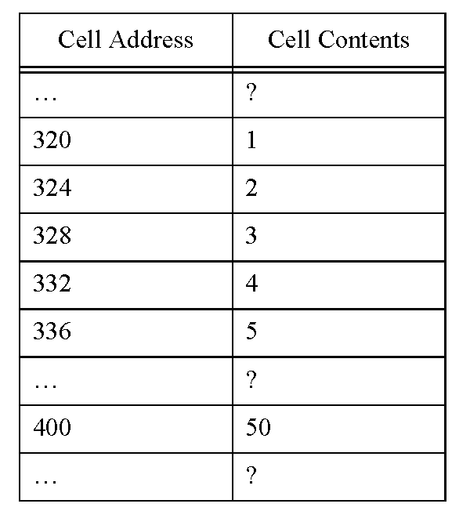
Matrices example, layout, part 1

Slide 15
Matrices example, layout, part 2
Cells 50-57: Allocated by first malloc
Cells 180-203: Allocated by second malloc
Cells 320-339: Allocated by third malloc
Cells 400-403: The “matrices” variable (allocated statically)

